Slide 1

Installing Anaconda on your laptop
Reza Dibaj

Slide 2
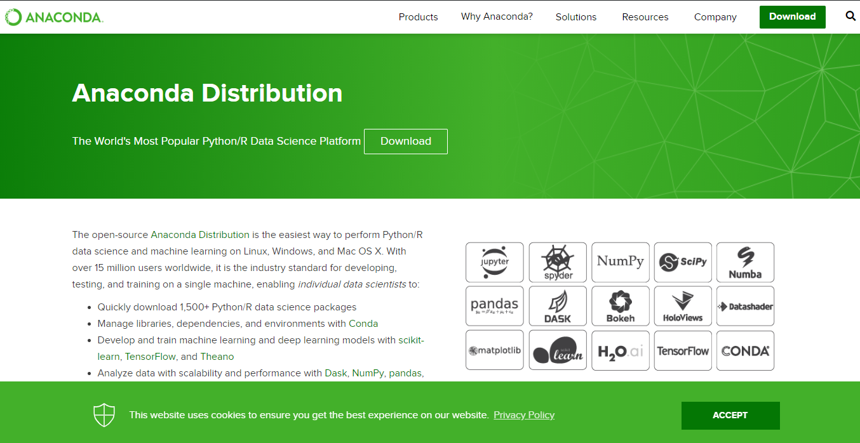
Anaconda Distribution of Python
Notes:
https://www.anaconda.com/distribution/

Slide 3
Anaconda Distribution of Python
2
1

Slide 4
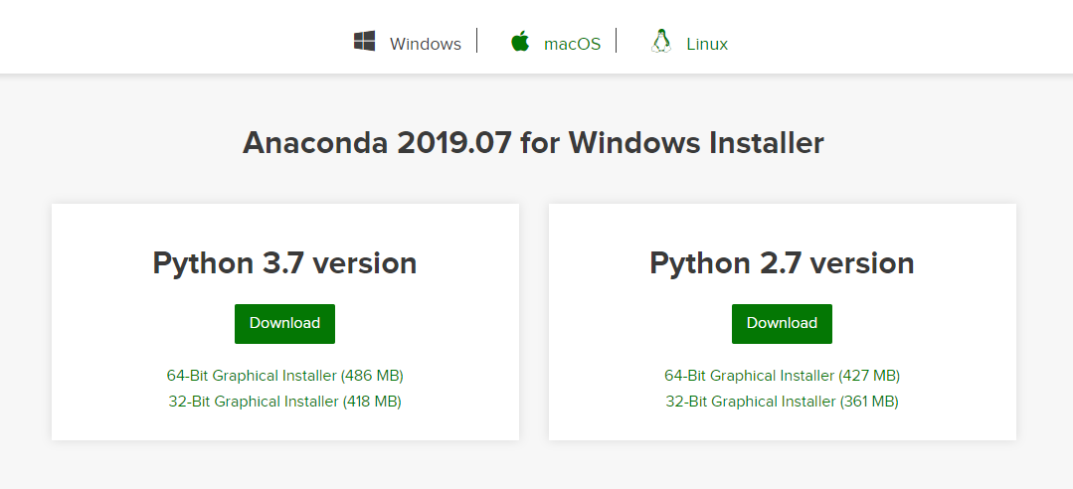
Anaconda Distribution of Python
1
2

Slide 5
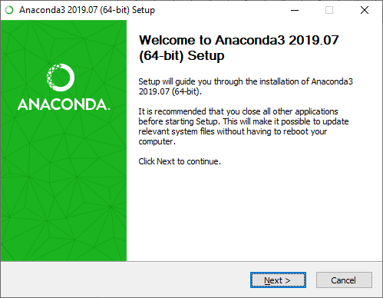
Installation Process
1
2

Slide 6
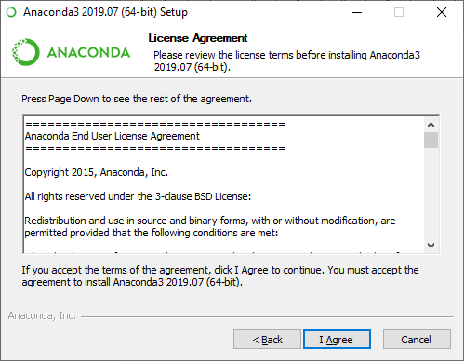
Installation Process

Slide 7
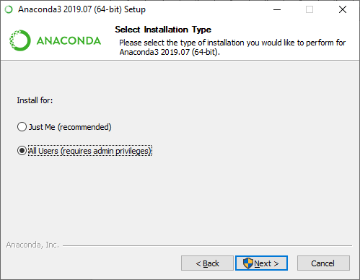
Installation Process
1
2

Slide 8
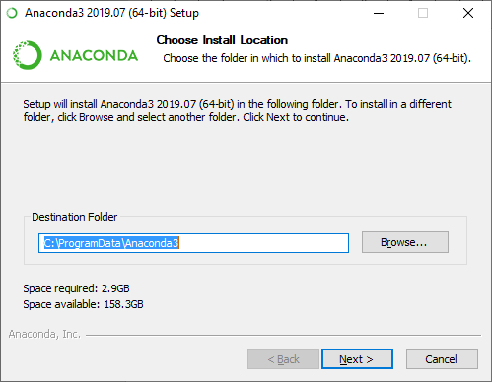
Installation Process
You can change the installation path or leave it as it is.
1
2

Slide 9
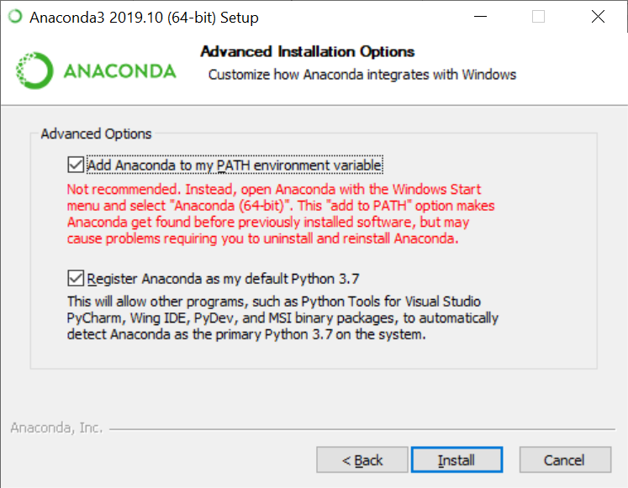
Installation Process

Slide 10
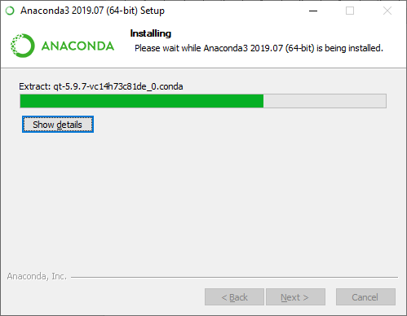
Installation Process

Slide 11
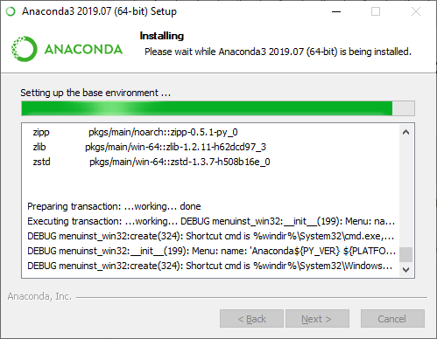
Installation Process

Slide 12
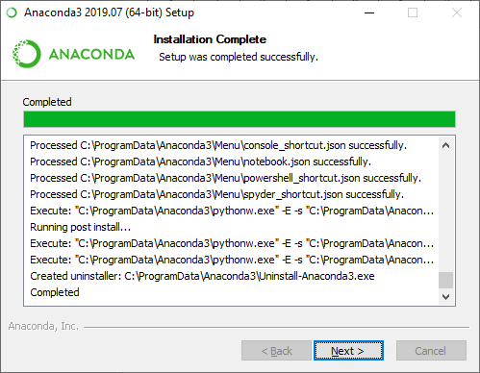
Installation Process

Slide 13
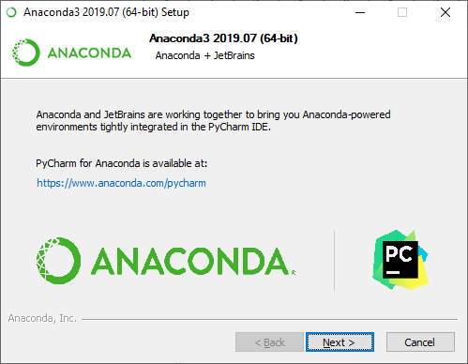
Installation Process

Slide 14
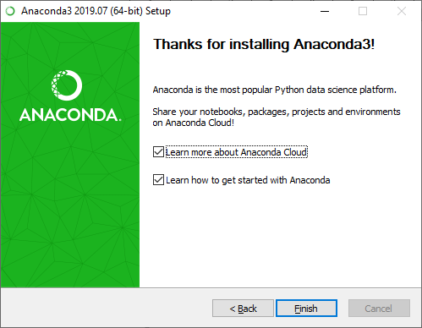
Installation Process

Slide 15
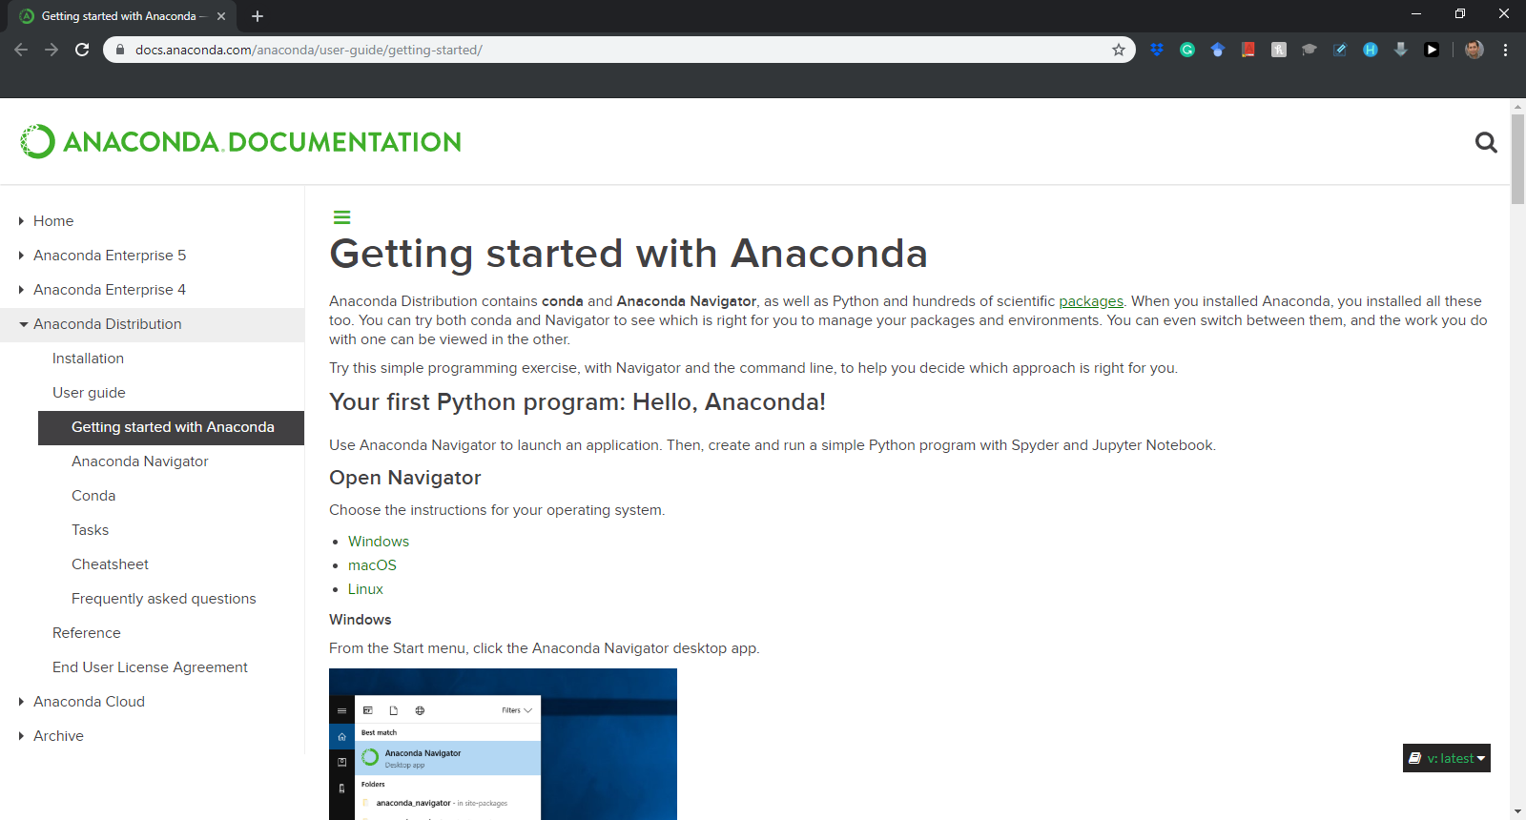
Installation Process
Notes:
https://docs.anaconda.com/anaconda/user-guide/getting-started/

Slide 16
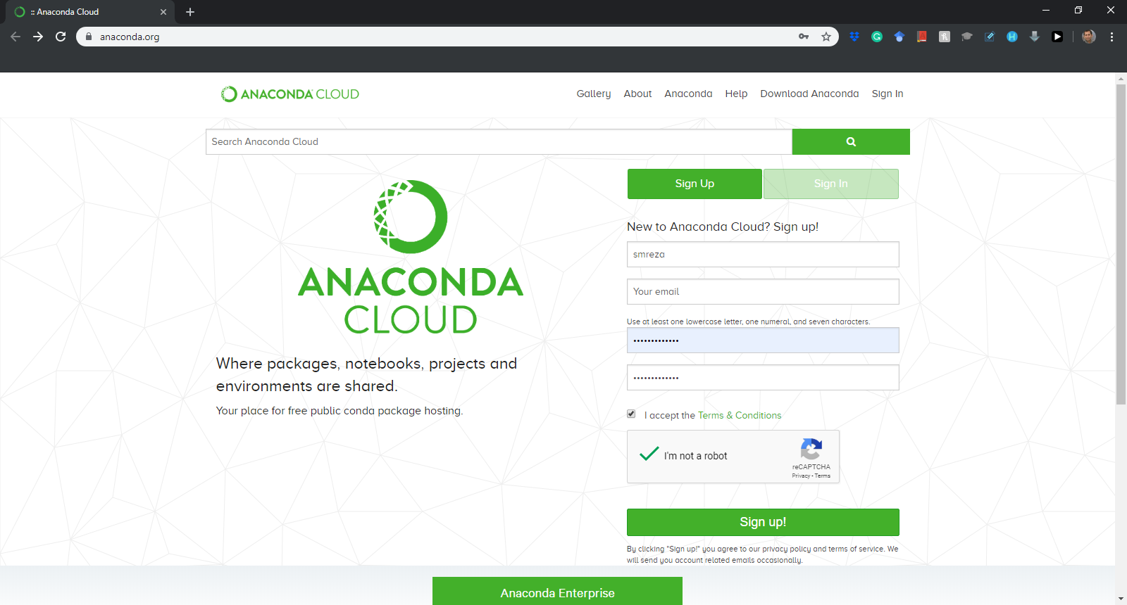
Installation Process
Sign up for the first time….
Notes:
https://anaconda.org/

Slide 17
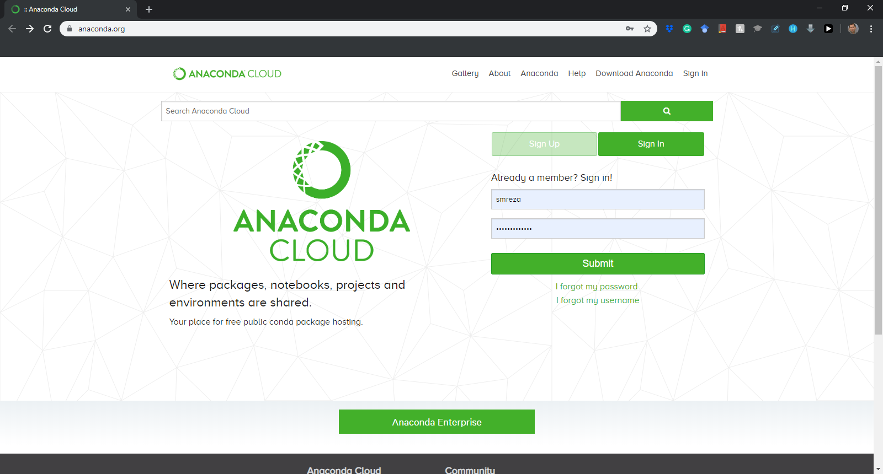
Installation Process
Sign in after the first time….
Notes:
https://anaconda.org/

Slide 18
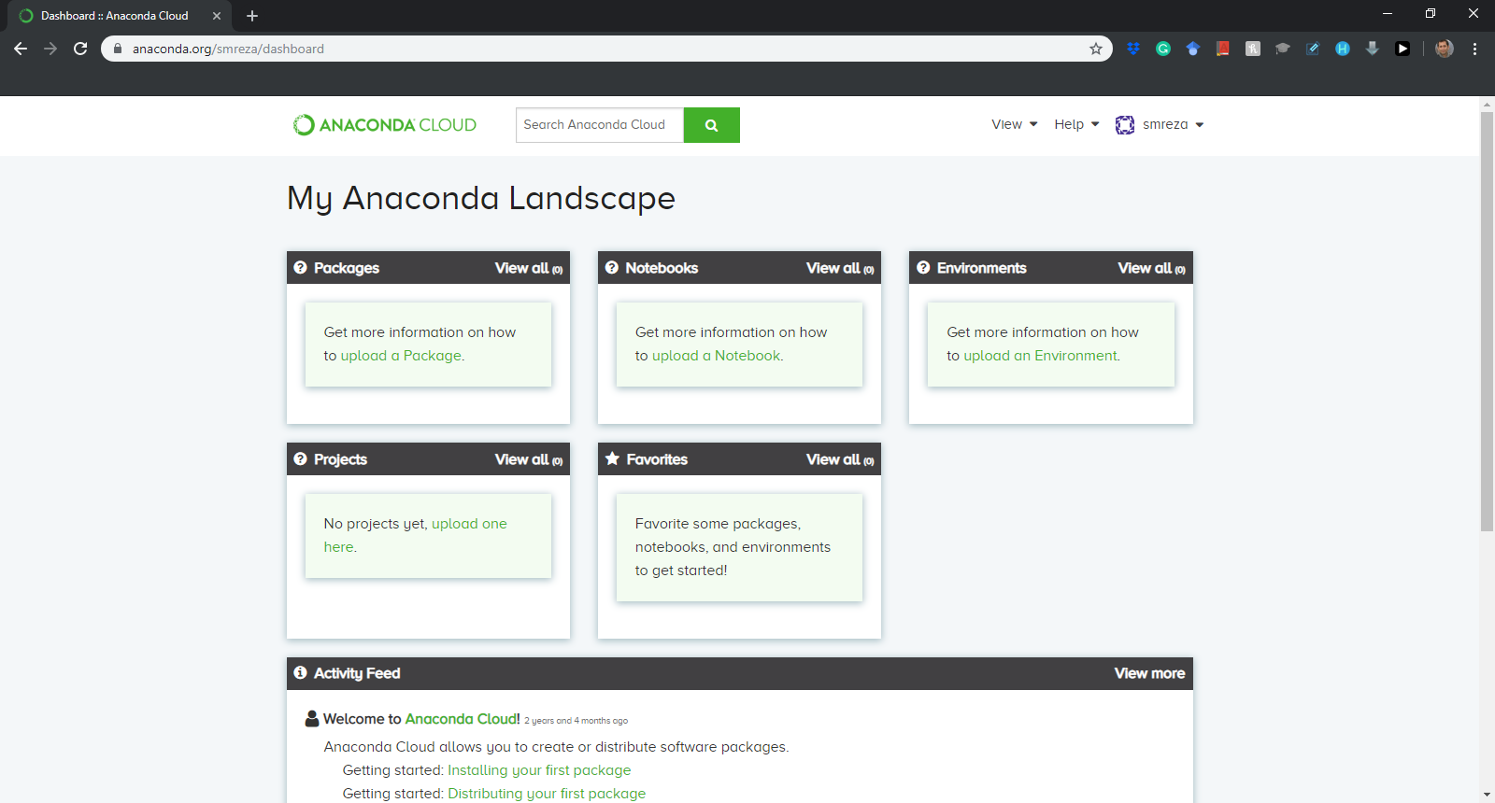
Installation Process

